Slide 1
UTILIZING MODEL-BASED SYSTEMS ENGINEERING TO MODEL DATA PROCESSING IN NASA SPACE MISSIONS
21st Annual Arizona Space Grant Consortium Symposium
The University of Arizona, Tucson, AZ
April 21, 2012
Gladys C. Amaya, UA Department of Systems and Industrial Engineering
Mentor: Dr. Roberto Furfaro, SPOC Systems Engineer, UA Department of Systems and Industrial Engineering

Slide 2
Presentation Outline
Mission Background
Science Processing & Operations Center (SPOC) Overview
Model-base systems engineering (MBSE)
MBSE at the SPOC
Results
Aspirations

Slide 3
Mission Objective and Background
NASA's New Frontiers Program
Spacecraft to be launched to asteroid, RQ36 in 2016
Utilize robotic arm to pluck samples
First U.S. mission to carry samples from an asteroid back to Earth
Samples to be analyzed by science groups
Reference: NASA Website: http://www.nasa.gov/topics/solarsystem/features/osiris-rex.html

Slide 4
Science Processing & Operations Center (SPOC)
Located at The University of Arizona’s Lunar and Planetary Lab
Working in conjunction with
  NASA Goddard Space Flight Center
  Lockheed Martin

Slide 5
New approach to Systems Engineering
NASA space mission challenges
  Establishing mission requirements
  Establishing communication/data paths across multiple teams
  Identifying risks and issues associated with time and resources
Model-based systems engineering (MBSE)
  Expedites the completion of tasks while reducing time and error
  Integrated design of the mission
Notes:
Traceability

Slide 6
Model-based systems engineering
The formalized application of modeling to
  Support system requirements
  Design
  Analysis
  Verification and Validation activities
Beginning in the conceptual design phase and continuing throughout development and later life cycle phases
  Reference: INCOSE-TP-2004-004-02, Version 2.03, September 2007

Slide 7


MBSE at the SPOC
Layered approach to development
Integrated requirements management
Executable behavior models
Architecture development tools
  subsystems and components
Validation and Verification (simulation)
  highlights gaps and missing functions
Comprehensive system documentation
Reference: http://www.vitechcorp.com/products/core.shtml
Notes:
Integrated requirements management ensure that you capture customer needs accurately
Fully executable behavior models help you unlock elegant functionality
Architecture development tools guide you swiftly to subsystems and components
Validation and Verification (simulation) highlights gaps and missing functions
Comprehensive system documentation ensures you deliver a complete solution with a clear message
Easy to use Parsers help you get information into the model quickly so you can build the solution correctly the first time. Reduce rework by verifying you’ve secured the right requirements early.
Simple Model Construction gives new users a flexible way to visualize the interactions between requirements, functions, and components so you can always keep your focus.
Multiple Modeling Notations help you evaluate the system through a variety of integrated graphical views: hierarchies, functional flow and enhanced functional flows, N2, IDEF0, and physical block. Change one diagram and see the update reflected on all impacted views.
Automated Document Creation helps you generate formal documentation, including DoDAF 2.0 views, instantly from the system definition database.

Slide 8
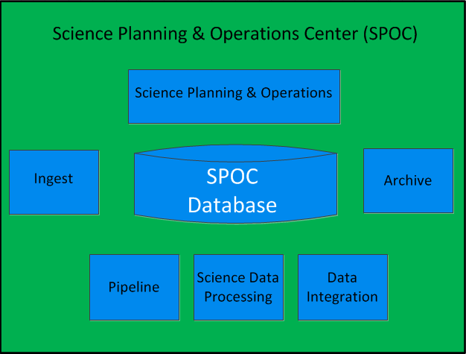
SPOC Structure
Instrument Telemetry
Sample Analysis Data
Science Data Products

Slide 9
Operational Interface Agreements (OIAs)
OIAs are signed receivable/deliverable items between teams and subteams of the operations system that represent necessary products to perform operational processes
Goal create and manage OIAs using CORE
So far we have about 300 OIAs total

Slide 10
SPOC Structure
Instrument Telemetry
Sample Analysis Data
Science Data Products

Slide 11
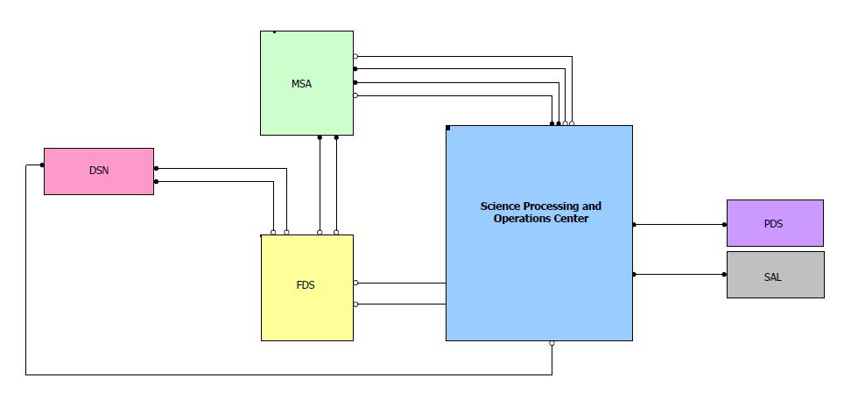
Physical-Block Diagram
Science Data Products
Science Data Products

Slide 12
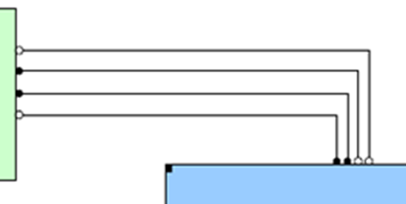
Physical-Block Diagram - Nodes

Slide 13
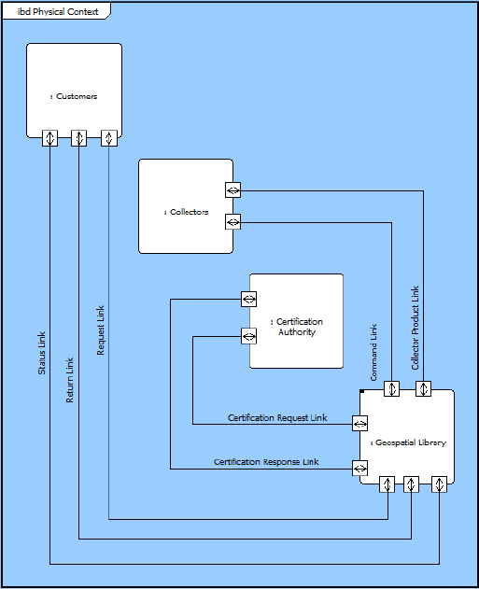
Flow Internal Block Diagram
Reference: http://www.vitechcorp.com/products/core.shtml

Slide 14
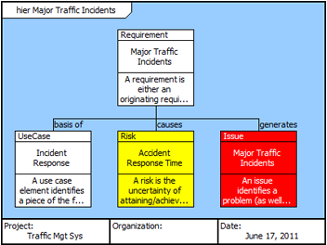
Requirements Hierarchy
Reference: http://www.vitechcorp.com/products/core.shtml

Slide 15
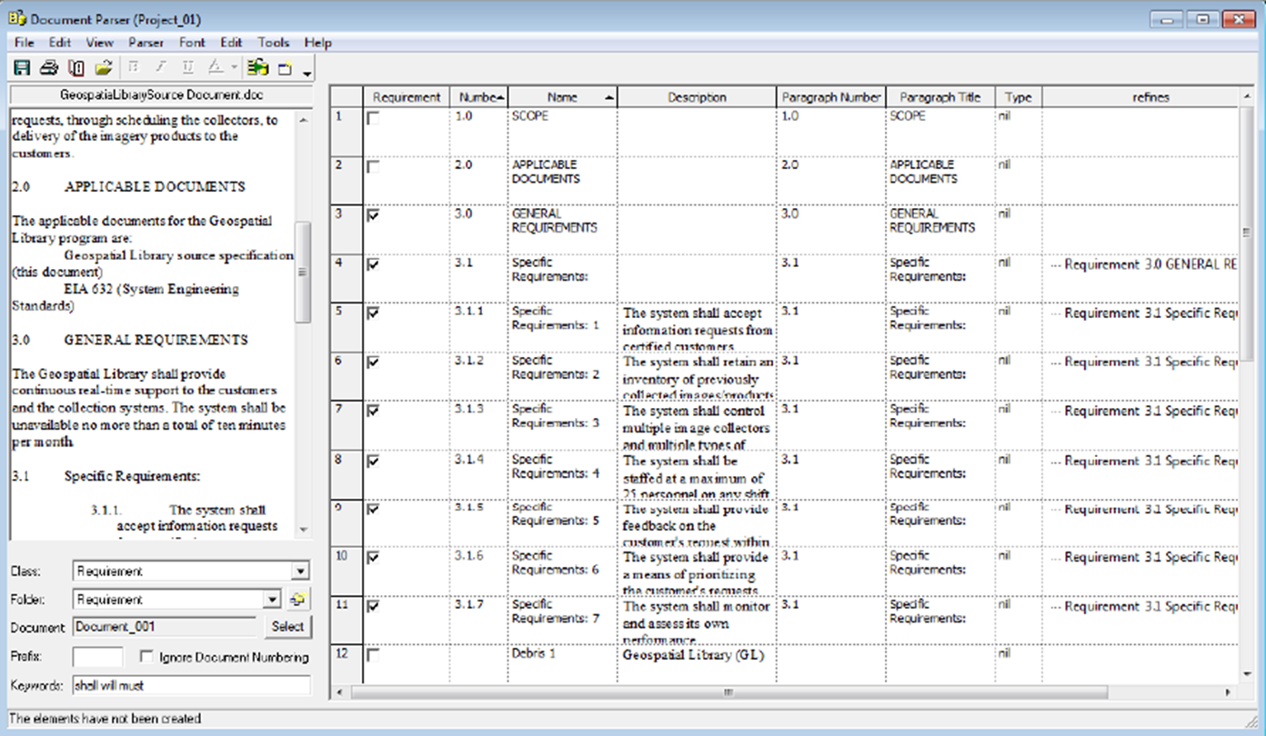
Integrated Requirements Management
Reference: http://www.vitechcorp.com/products/core.shtml

Slide 16
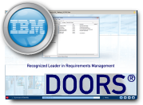
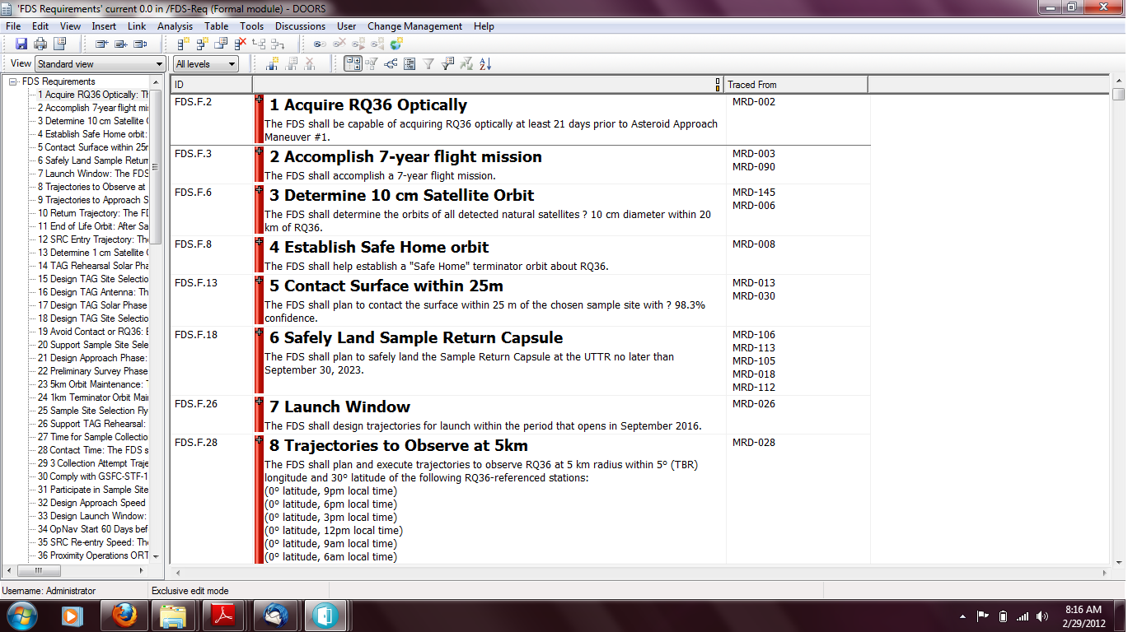



Migrating Requirements
Requirements and links exported to DOORS using CSV (excel) files
Requirements
Requirements

Slide 17
Benefits of MBSE at the SPOC
Rapid retrieval of mission information for validation and verification purposes
Traceability
Consistency of processes and activities with the established mission requirements

Slide 18
Aspirations
Continue learning more about CORE
Continue modeling the mission
Quantify the benefits of MBSE
Exploit the benefits
Have a successful mission!
Continue applying MBSE to future NASA missions

Slide 19
Acknowledgements
OSIRIS-REx Systems Engineering Team:
  Dr. Roberto Furfaro
  Daniel Wibben
  John Kidd
  Sara Balram
NASA Goddard Space Flight Center
  Darryl D. Lakins, Systems Engineer, CORE expert

Slide 20
Thank you!
Gladys C. Amaya
gladysa@email.arizona.edu

